Slide 1

Sustainability Tracking, Assessment & Rating System
June 14, 2022

Slide 2
TABLE OF CONTENT
TABLE OF CONTENTS
STARS Snapshot
Data Analysis
Recommendations

Slide 3

STARS SNAPSHOT
STARS SNAPSHOT
STARS is a transparent, self-reporting framework for colleges and universities to measure their sustainability performance.
ESTABLISHED: 2010 by AASHE - the leading association for the advancement of sustainability in higher education
RATING SYSTEM:

Slide 4
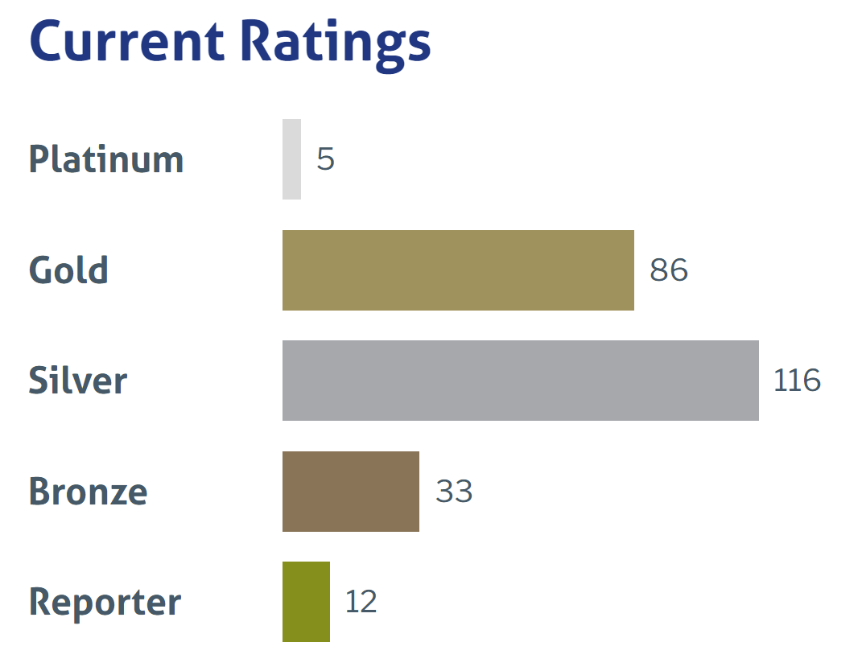
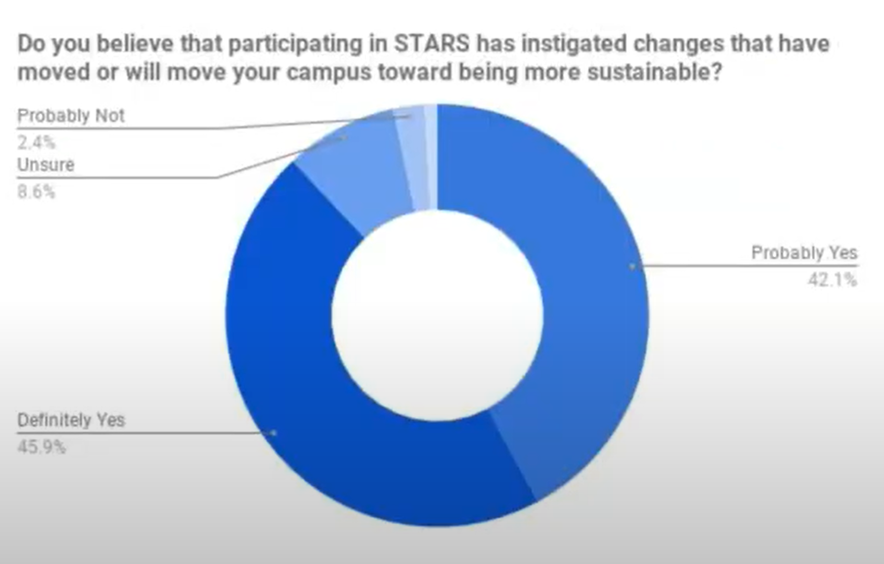
STARS SNAPSHOT
STARS STATISTICS

Slide 5
STARS CREDIT
STARS CATEGORIES & SUBSCATEGORIES
AC
ACADEMICS – 58.00
Curriculum 40.00
Research 18.00
OPERATIONS – 71.00
Air & Climate 11.00
+ Emissions Inventory and Disclosure – 3.0
+ Greenhouse Gas Emissions – 8.00
Buildings 8.00
Energy 10.00
+ Building Energy Efficiency – 6.00
+ Clean and Renewable Energy – 4.00
Food & Dining 8.00
Grounds 4.00
Purchasing 6.00
Transportation 7.00
Waste 10.00
Water 6.00
EN
ENGAGEMENT – 41.00
Campus Engagement 21.00
Public Engagement 20.00
PLANNING AND ADMINSTRATION – 32.00
Coordination & Planning 9.00
Diversity & Affordability 10.00
Investment & Finance 6.00
Wellbeing & Work 7.00
INNOVATION & LEADERSHIP – 4.50
Innovation & Leadership 4.50
OP
PA
IN

Slide 6
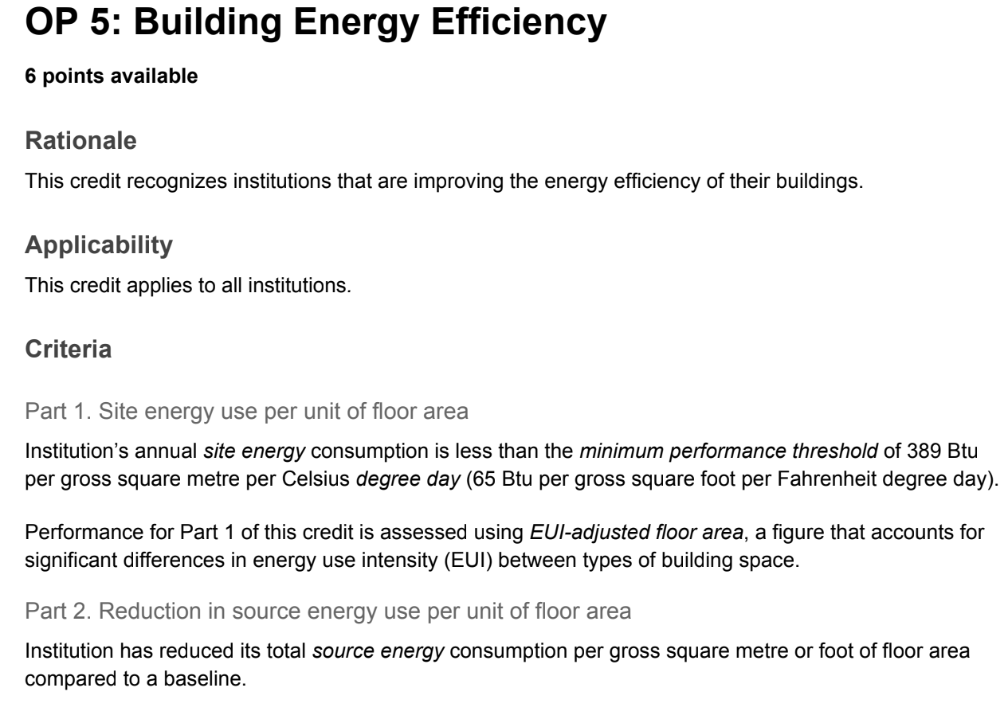
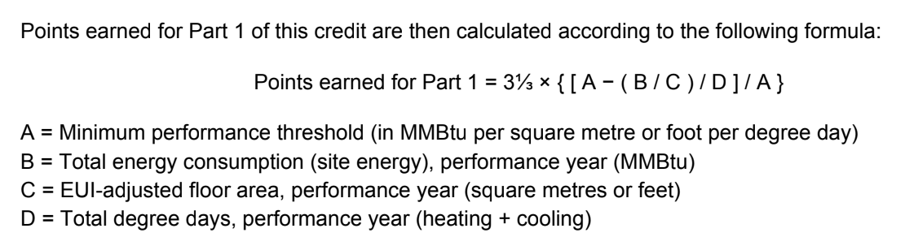
STARS SNAPSHOT
BUILDING ENERGY EFFICIENCY
► Sapient solution can help institutions earn no more than 1 point.

Slide 7
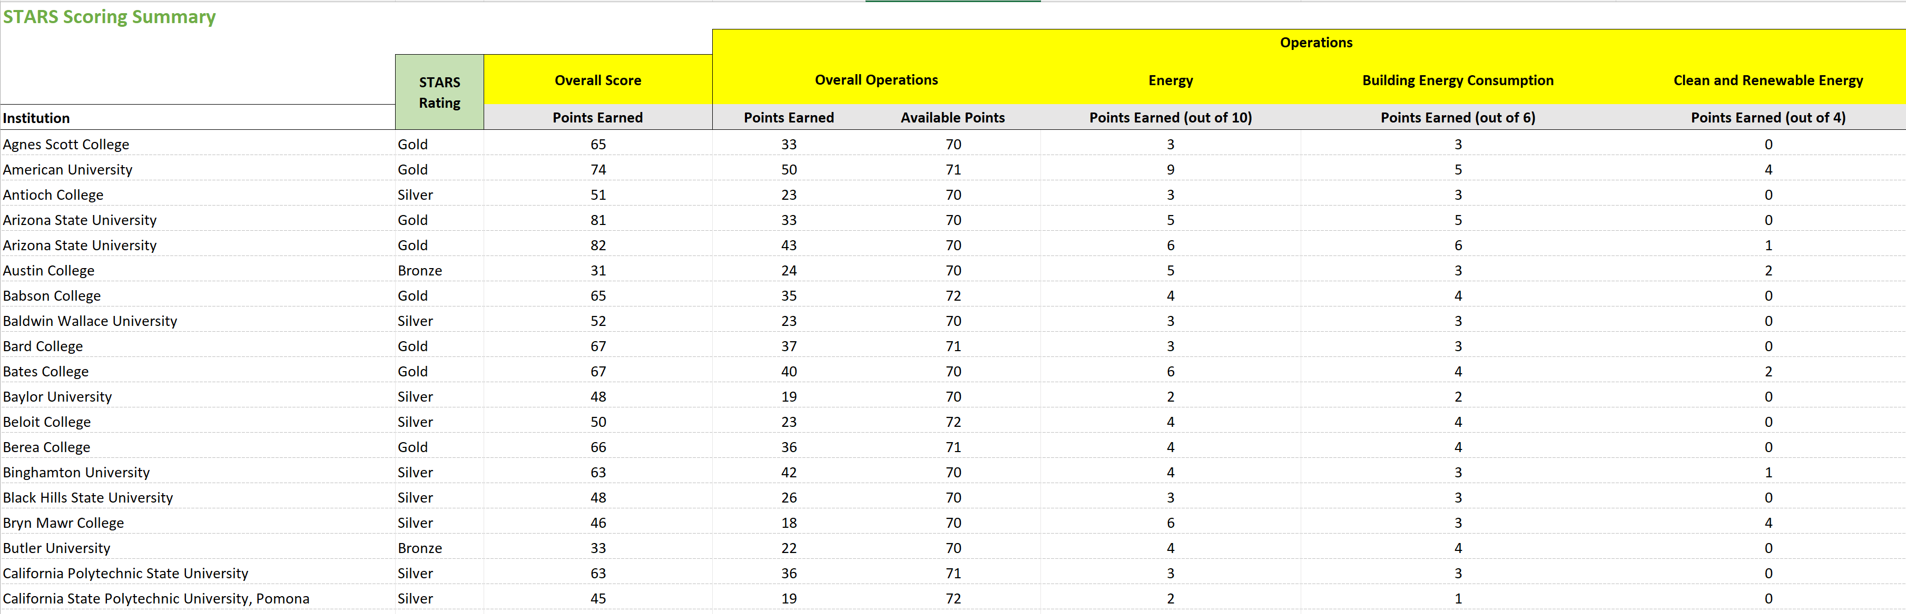
DATA ANALYSIS
Data Overview
Records of more than 200 US institutions sustainability performance based on their STARS score version 2.1
Details information of energy credit (total 10 points): Building Energy Efficiency – 6.00 points and Clean and Renewable Energy – 4.00 points

Slide 8
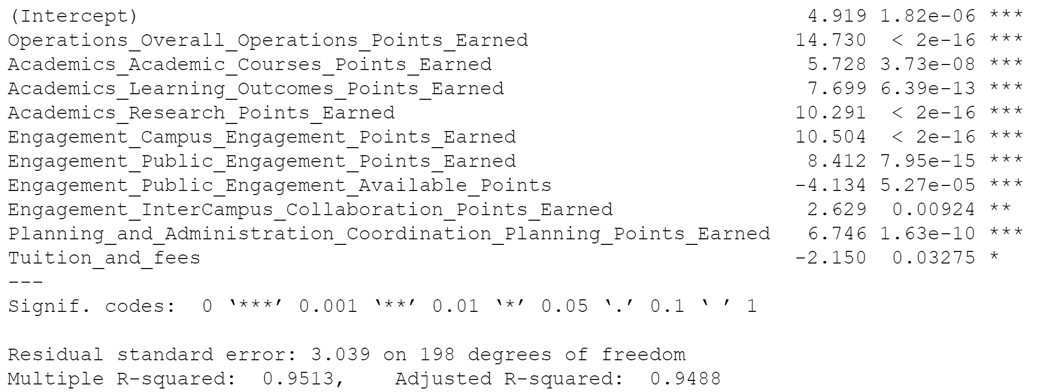
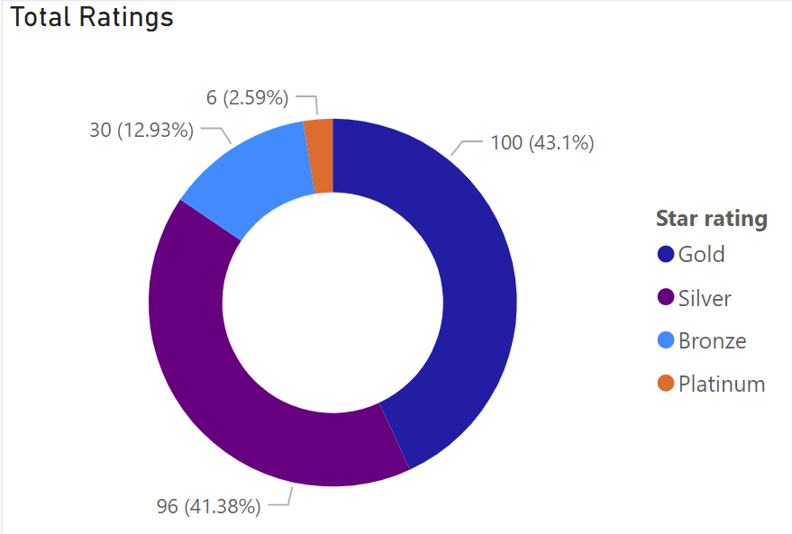
DATA ANALYSIS
DATA EXPLORATION

Slide 9
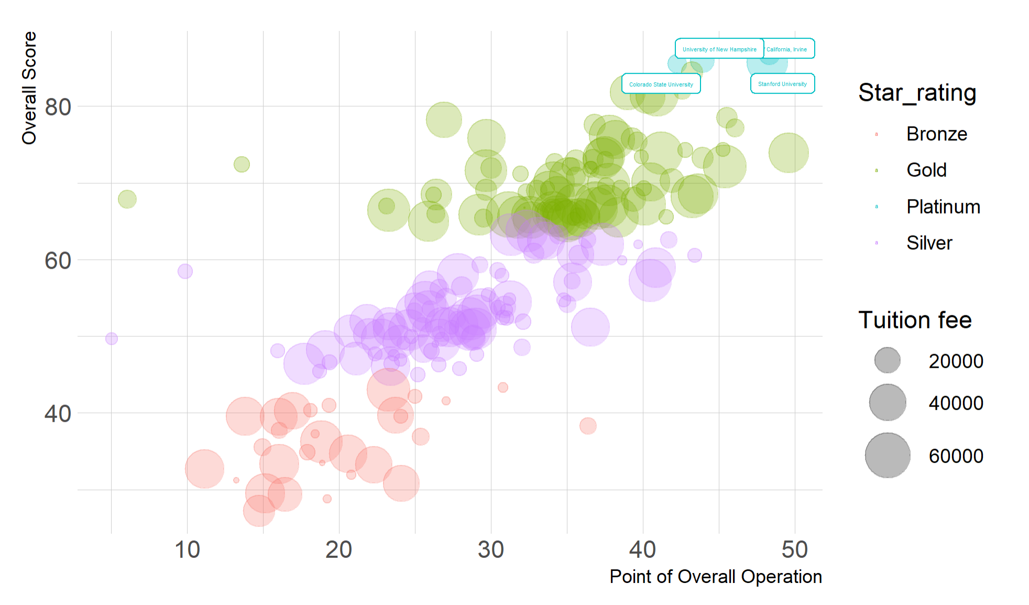
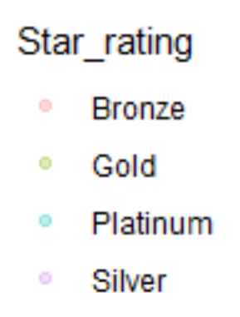
DATA ANALYSIS
DATA ANALYSIS
Institutions who has high STAR rating tends to have higher Overall Operation Score
Tuition fee does not have much correlation with the STAR rating.
Notes:
Operations contribute to the points of STARS

Slide 10
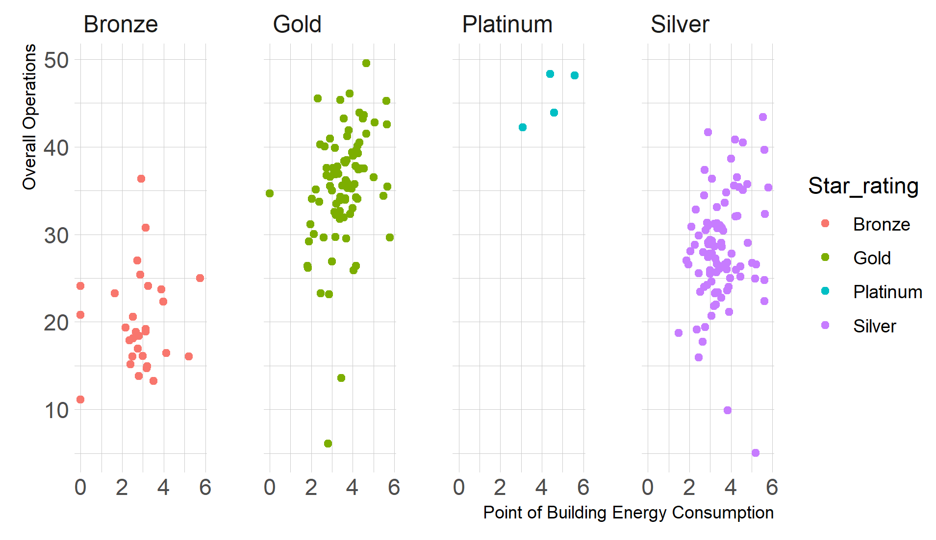
DATA ANALYSIS
DATA ANALYSIS
The relationship of Building energy consumption factors and Overall Operation is not clear.

Slide 11
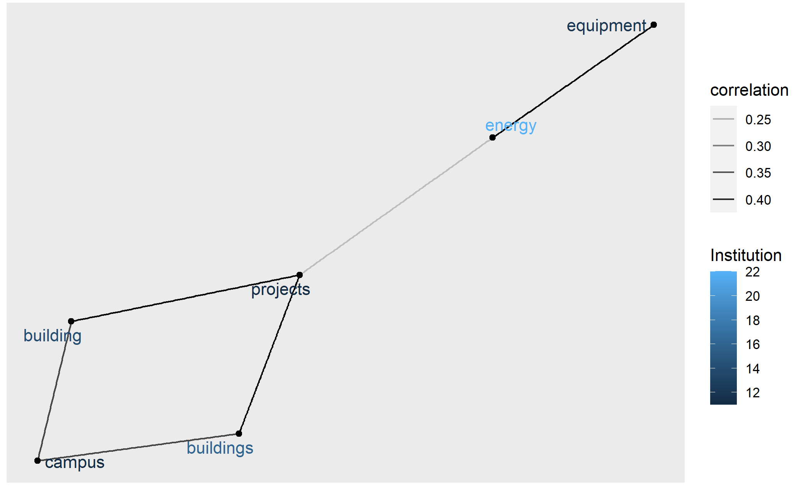
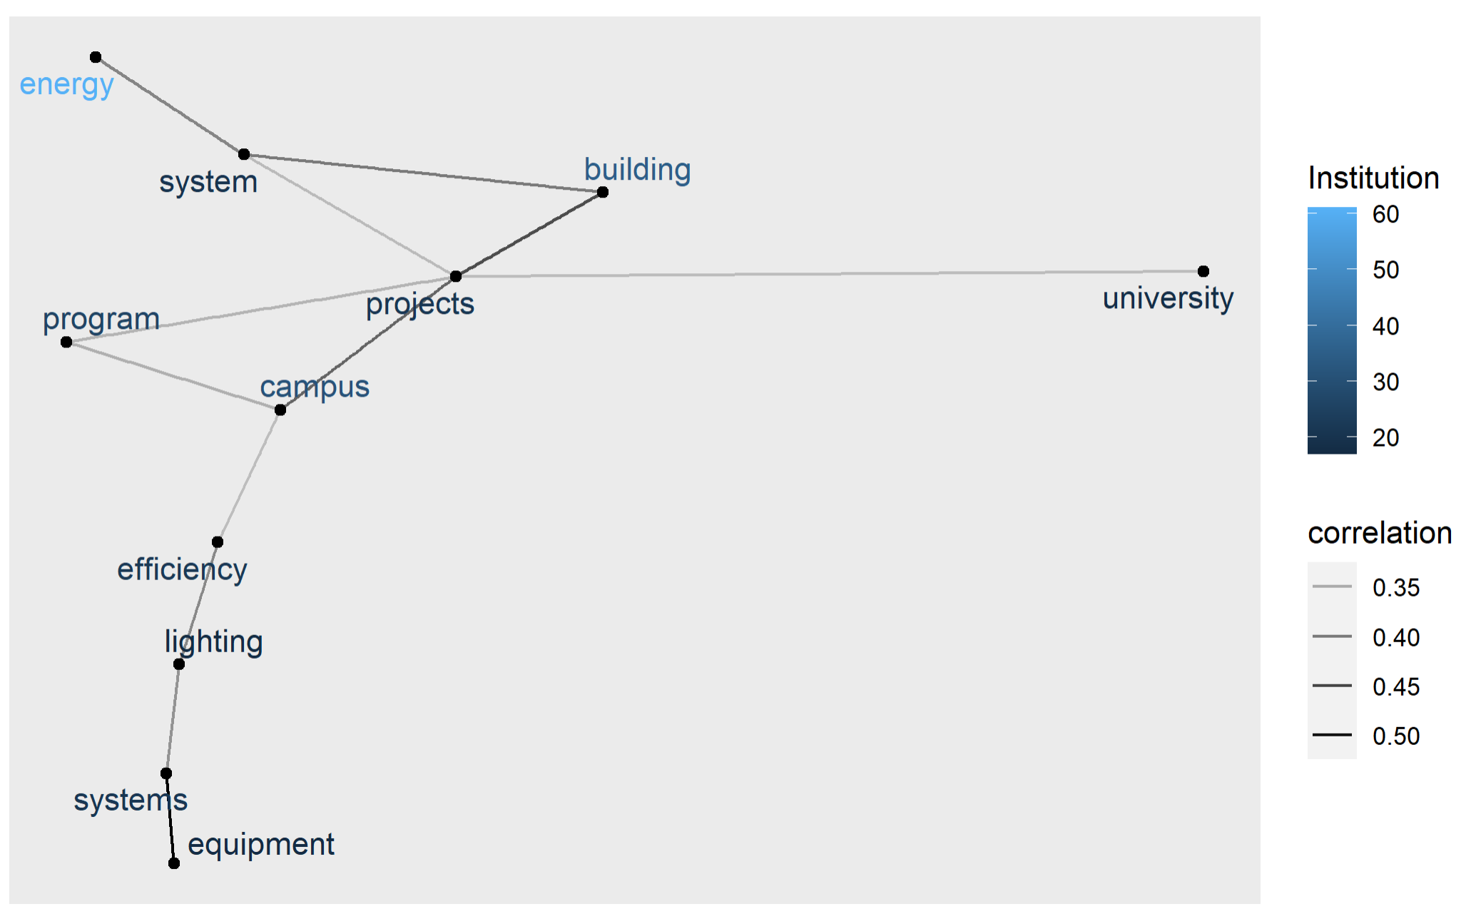
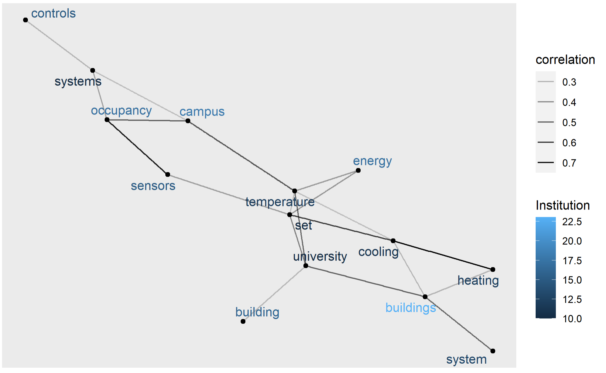
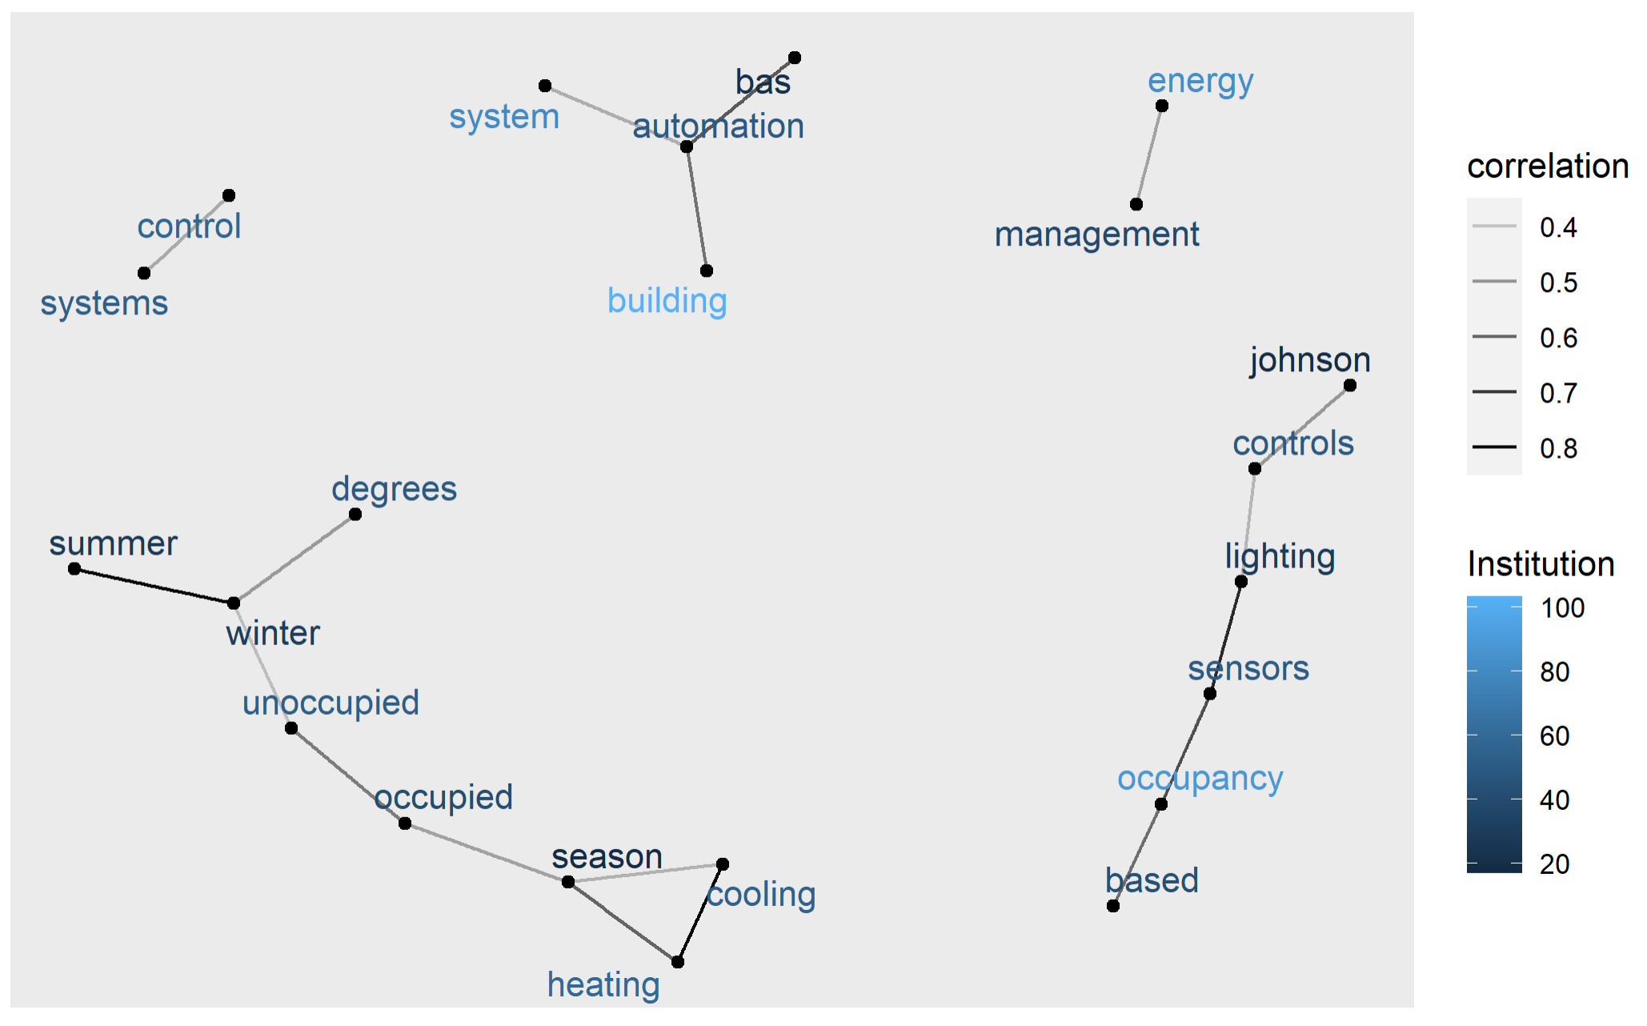
DATA ANALYSIS
TEXT ANALYSIS
A brief description of the institution's initiatives to shift individual attitudes and practices in regard to energy efficiency (e.g. outreach and education efforts)
Energy Score ≤ 2
Energy Score ≥ 3
Energy Score ≤ 2
A brief description of energy use standards and controls employed by the institution (e.g. building temperature standards, occupancy and vacancy sensors)
Energy Score ≥ 3

Slide 12
Recommendations
CONCLUSIONS AND RECOMMENDATIONS
Overall, Sapient can contribute to the Energy and Air & Climate categories, specifically the Emissions Inventory and Disclosure, Greenhouse Gas Emissions and Building Energy Efficiency credits.
- For the Building Energy Efficiency credits, Sapient can help institution earn no more than 1 point
(The maximum point given to the part 1 of the Building Energy Efficiency credits is 3)
Sapient can target some institutions who score high on other categories and do not invest or score low in the Building Energy Efficiency credits, but show great determination to adopt the Sustainable Development Goals (SDGs) – a voluntary set of objectives that were adopted by all UN Member States in 2015 or involve in many Sustainability practices
- Columbia University – Gold Rating but have not involve much in the Building Energy Efficiency credits
- East Carolina University – Bronze Rating and is installing in LED and more efficient fluorescent fixtures in existing buildings
- University of Illinois at Chicago – Silver Rating. UIC was driven by gas and electric utility energy efficiency incentives to replace energy-consuming HVAC equipment and lighting
- University of Pennsylvania – Gold Rating. Buildings are managed 24 hours per day using a central Building Management System (BMS) system. $200M worth of funds raised through bond sales are being applied towards projects in which energy conservation and deferred maintenance converge

